Slide 1


ANKITA ANAND
IIT GUWAHATI
J.P. MORGAN QUANT CHALLENGE 2023
MACHINE LEARNING & DATA SCIENCE

Slide 2





APPROACH
Data Cleaning
&
Manipulations
Exploratory
Data Analysis
Model Architecture
Model Evaluation

Slide 3




DATA CLEANING & MANIPULATIONS
ADDITION OF NEW COLUMNS
REASONING BEHIND REMOVAL
-Adding "current_ratio" ,"Debt2equity_ratio" and
" Dividend_payout" columns in the dataset
-Adding separate columns for year and month.
Reducing Redundancy: When a column is used to create another column, it introduces redundancy in the dataset. Redundancy means that the same information is duplicated or represented in multiple places.
ADDITION
REMOVAL OF REDUNDANT COLUMNS
'dividend','net_income',
'current_liabilities',
'current_assets',
'liabilities','equity'.
These columns were removed.
REMOVAL
REASONING
CURRENT_RATIO = CURRENT_ASSETS/CURRENT_LIABILITIES
DIVIDEND_PAYOUT=DIVIDEND/NET_INCOME
TOTAL_ASSETS=EQUITY- LIABILITIES
DEBT-TO-EQUITY RATIO = TOTAL LIABILITIES / EQUITY

Slide 4








EXPLORATORY
Data Analysis

Slide 5
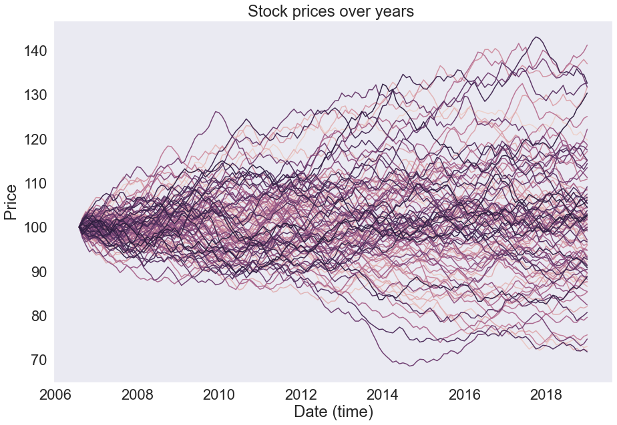
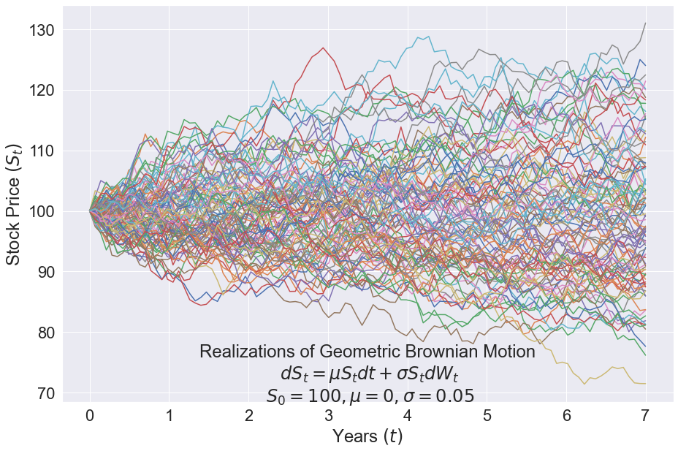
FACTORS
STOCK PRICES
Company Financial Performance: Factors such as liabilities, equity, total assets, current assets, current liabilities, total revenue, net income, dividend, and shares outstanding are all related to a company's financial performance. The stock market is influenced by how well a company is performing financially. Positive financial performance, including higher revenue, profits, and strong balance sheets, can have a positive impact on stock prices.
1+
GEOMETRIC BROWNIAN MOTION
100
All the Stock prices have started at 100 and changed over time. Their distribution is similar to 100 Geo. Brownian motions simulations.

Slide 6
Number of Stocks(lag 0)
STATIONARITY TESTING:
Number of Stocks(lag 1)
Number of Stocks(lag 2)
Number of Stocks(lag 3)
100
AUGMENTED DICKEY-FULLER (ADF) TEST
BAR GRAPH TO SHOW NUMBER OF STOCKS HAVING P-VALUE IN CERTAIN RANGES AFTER N LAGS
75
Out of the 100 given stocks, a total of 94 stocks exhibited an Augmented Dickey-Fuller (ADF) test statistic or p-value above the critical value of 0.05 at lag 0.
94
After analyzing the data using the Augmented Dickey-Fuller (ADF) test, it was observed that, among the tested stocks, 89 additional stocks passed the ADF test after introducing a lag of one. Furthermore, it was found that the maximum number of lags required for a stock to pass the ADF test was three.
50
89
25
PROPERTY OF TIME SERIES
Time series data often exhibits stationarity, which means that statistical properties such as mean, variance, and autocorrelation remain constant over time.
0
ABOUT THE ADF TEST
0.0-0.5
0.5-0.15
0.15-0.30
0.30-0.50
0.50-0.70
0.70-1.00
The ADF test examines the presence of a unit root in the autoregressive model of the time series. A unit root indicates that the time series has a stochastic trend and is non-stationary.
P-VALUE RANGE

Slide 7
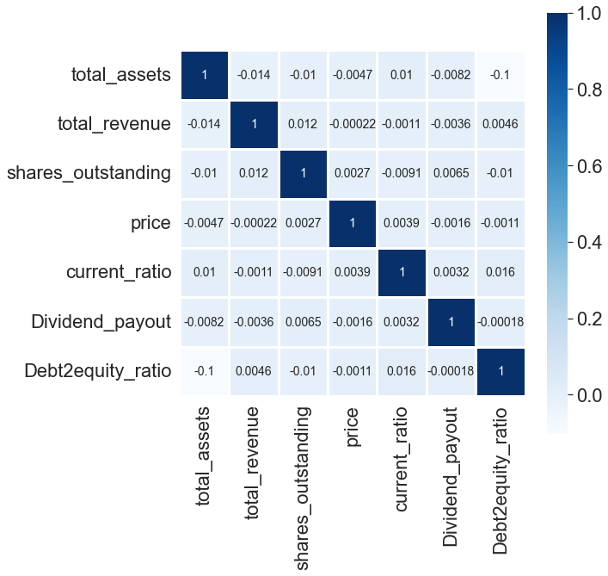
CORRELATION MATRIX
FINDING LINEAR RELATIONSHIP OF STOCK PRICES WITH OTHER ENTITIES
Since none of the correlation found is greater than 0.2 or less than -0.2 , the relationship between Stock prices and other columns present in dataset is not linear.
Therefore Linear , Ridge and Lesso Regression performed poorly.

Slide 8
MODEL ARCHITECTURE

Slide 9


MODEL ARCHITECTURE
LIGHT
GBM
ENSEMBLE OF STRONG MODELS
MODEL THAT CAN HANDLE AUTOREGRESSIVE NATURE OF DATASET AND CAN ALSO TAKE CONSIDERATION OF MULTIVARIABLE FACTORS.
LIGHT GBM
RANDOM FOREST
AVERAGE OF OUTPUT
FOR MULTIVARIABLES
AVERAGE OF OUTPUT
GRADIENT BOOSTING
GEOMETRIC BROWNIAN MOTION (GBM)
FOR AUTOREGRESSIVE NATURE
AUTOREGRESSION
The autoregressive model specifies that the output variable depends linearly on its own previous values and on a stochastic term (an imperfectly predictable term); thus the model is in the form of a stochastic difference equation.

Slide 10

ENSEMBLE MODELS
Ensemble models are a machine learning approach to combine multiple other models in the prediction process.
GRADIENT BOOSTING
LIGHT GBM
A gradient boosting framework that is designed to be fast, efficient, and highly scalable.
LightGBM uses a leaf-wise tree growth strategy, where each tree is grown leaf-wise instead of level-wise.
LightGBM calculates feature importance based on the number of times a feature is used for splitting across all the trees in the ensemble. This information can be valuable for feature selection, understanding feature contributions, and identifying important variables in the dataset.
An ensemble learning method that combines multiple weak learners, typically decision trees, to create a strong predictive model.
The key idea behind Gradient Boosting is to optimize the model by minimizing a loss function using gradient descent
RANDOM FOREST
Combines multiple decision trees to create a robust and accurate predictive model.
Randomly selects subsets of the training data through a process called bootstrapping
Random Forest provides a measure of feature importance based on how much each feature contributes to the model's overall performance. This information can be used for feature selection, identifying relevant variables.
GRADIENT BOOSTING
LIGHT GBM
RANDOM FOREST

Slide 11
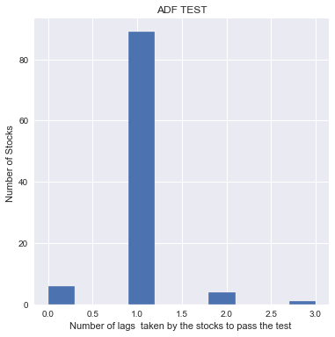
AUTO ARIMA
SOME LIMITATIONS OF ARIMA MODEL PREDICTIONS
KEY CHARACTERISTICS
OF ARIMA MODELS
ARIMA models primarily focus on the time series itself and do not inherently incorporate external factors or covariates. While exogenous variables can be included in ARIMA models as inputs, the model's ability to capture complex interactions with external factors may be limited
ARIMA models incorporate the autoregressive component, which captures the linear relationship between the current value of the time series and its lagged values.
The moving average component of ARIMA models considers the weighted sum of the error terms (residuals) from previous periods. It accounts for the short-term random fluctuations or shocks that affect the time series.
Sensitivity to Model Parameters: The performance of ARIMA models is highly dependent on the appropriate selection of model parameters, including the order of autoregressive (p),and moving average (q) components
Integration (I) Component: handles non-stationarity in the time series. It involves differencing the series to make it stationary by removing trends, seasonal patterns, or other non-stationary behavior.
Considering the limited size of the training dataset, which consists of only 150 observations for each stock, it is expected that ARIMA model predictions will exhibit large prediction intervals.

Slide 12
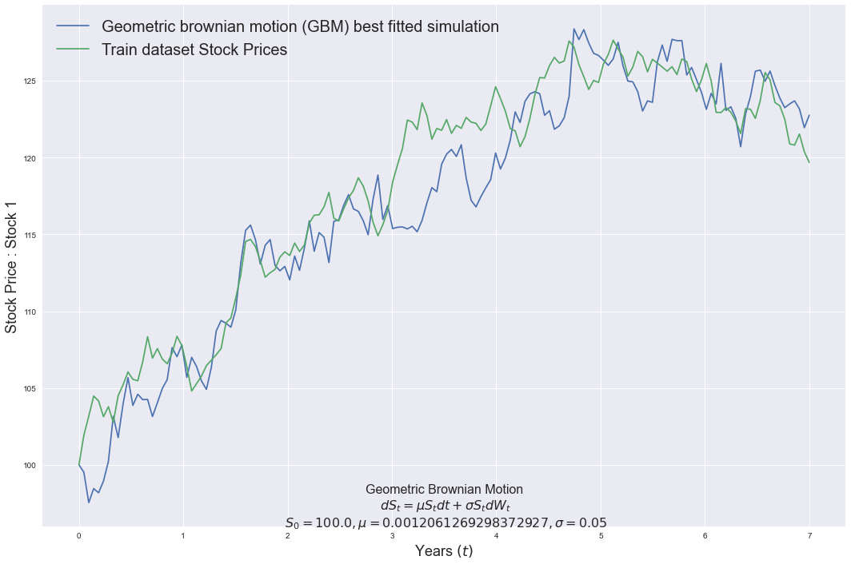
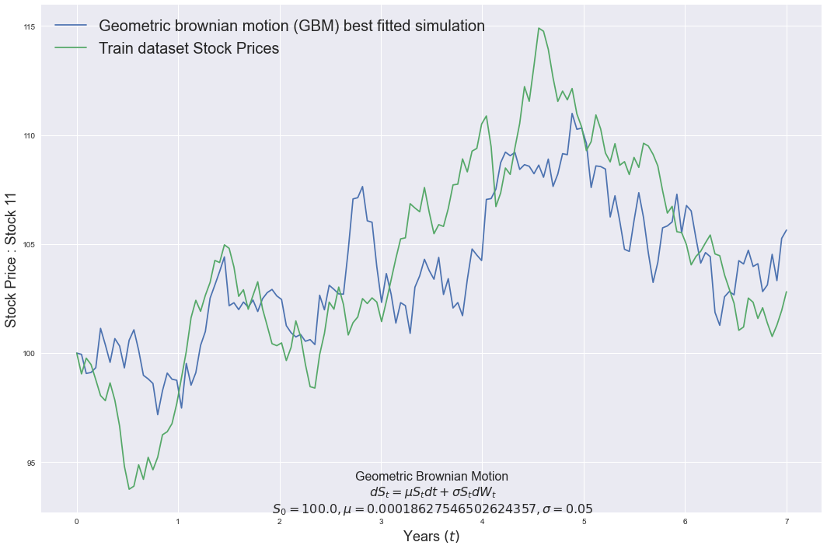
GEOMETRIC BROWNIAN MOTION (GBM)
The autoregressive equation for GBM can be represented as:
S(t) = S(t-1) * exp((μ - 0.5 * σ^2) * Δt + σ * ε * √(Δt))
In this equation:
S(t) represents the stock price at time t.
S(t-1) represents the stock price at the previous time step (t-1).
μ represents the drift or average rate of return of the stock.
σ represents the volatility or standard deviation of the stock's returns.
Δt represents the time interval between t and t-1.
ε represents a standard normal random variable.
Geometric Brownian Motion (GBM) is a mathematical model used to describe the stochastic movement of a variable over time, often applied to model stock prices and financial assets. It is a continuous-time process that assumes the variable follows a log-normal distribution.

Slide 13
GEOMETRIC BROWNIAN MOTION (GBM)
I generated simulations of Geometric Brownian Motion (GBM) with a mean equal to the mean of the training data for a specific stock and variance equals to 0.05. From these simulations, I selected the simulation that best fit the training data for that stock. I determined the best fit simulation by comparing the mean squared error (MSE) between the simulated prices and the prices from the training data. If the RMSE between the simulation and training data prices was less than 3.0, I considered that simulation as the best fit for the particular stock.
Geometric Brownian Motion (GBM) is a mathematical model used to describe the stochastic movement of a variable over time, often applied to model stock prices and financial assets. It is a continuous-time process that assumes the variable follows a log-normal distribution.

Slide 14
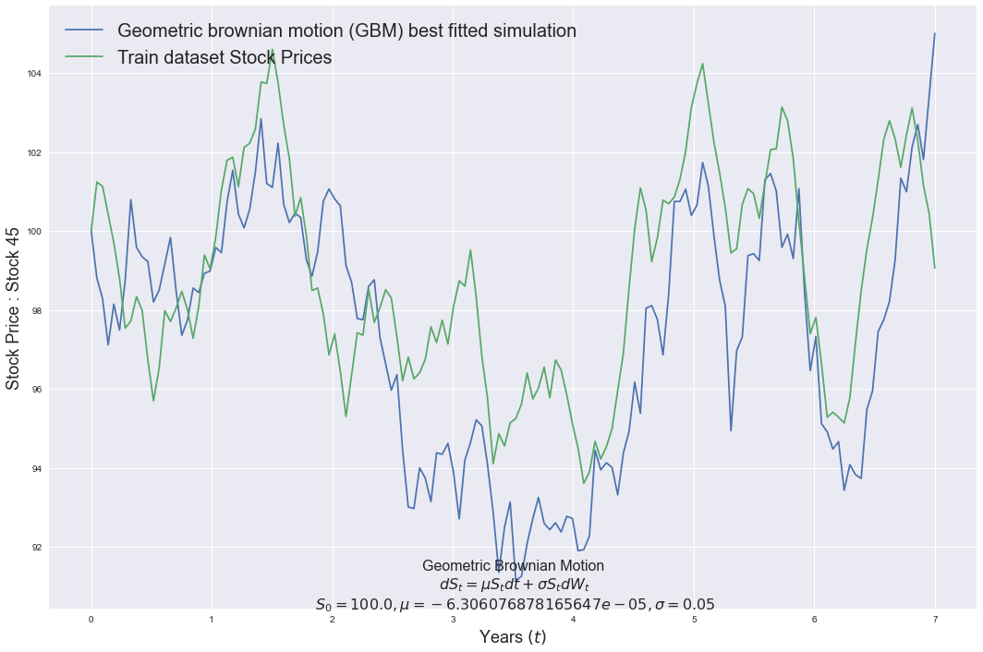
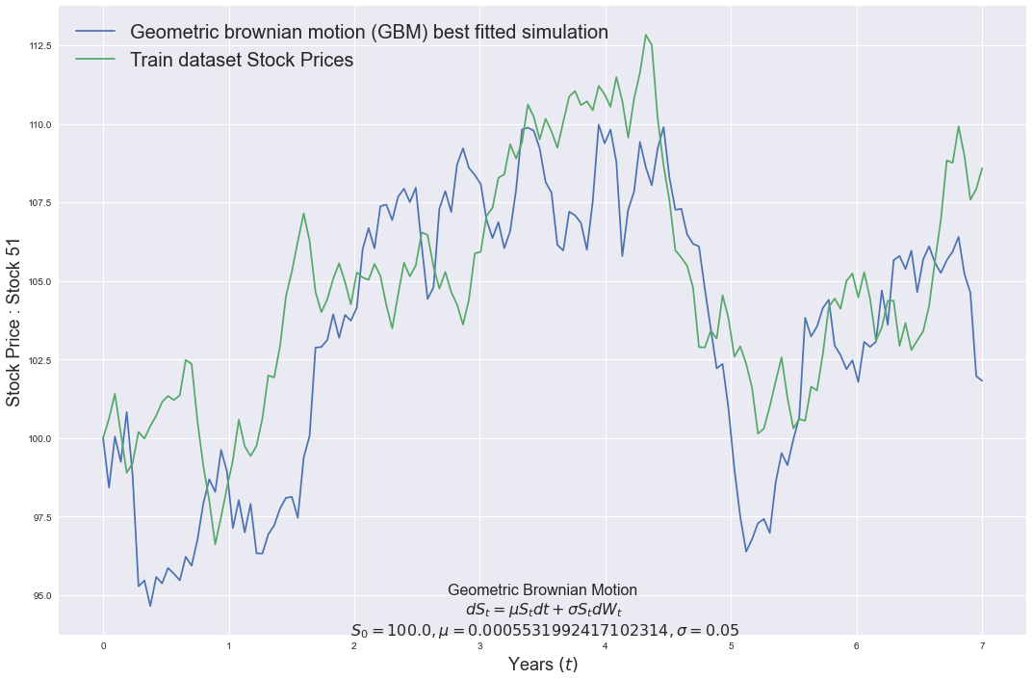
GEOMETRIC BROWNIAN MOTION
(GBM)
VOLATILITY CLUSTERING TEST:
GBM assumes constant volatility over time, meaning that the variance of returns remains constant.
Calculated the squared returns (or absolute returns) and examined their volatility pattern.
Conducted test for volatility clustering, GARCH test.

Slide 15
MODEL EVALUATION

Slide 16
ENSEMBLE MODELS
The accuracy given here are, The coefficient of determination, or R2 , and it is a measure that provides information about the goodness of fit of a model. In the context of regression it is a statistical measure of how well the regression line approximates the actual data.
Random Forest
LightGBM
Gradient Boosting
Accuracy
(in percentage) of
Random Forest : 96.7807
Root mean Squared error : 1.8467
Accuracy of
(in percentage)
LightGBM: 87.11734
Root mean Squared
error : 3.6943
Accuracy of (in percentage)
Gradient Boosting: 95.93349
Root mean Squared error : 2.0755

Slide 17
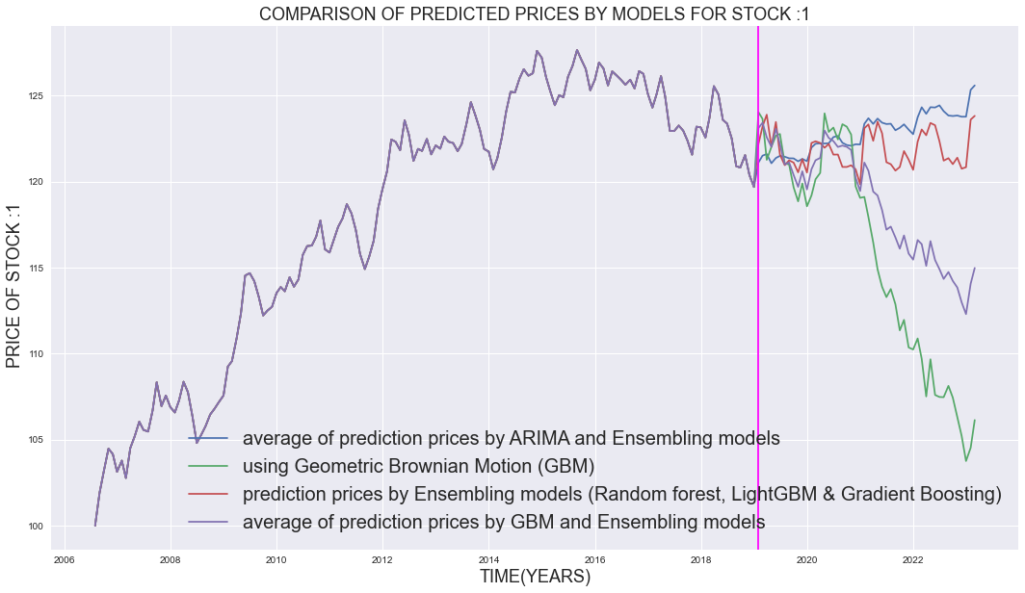
COMPARISON OF MODEL PREDICTIONS.
Considering the limited size of the training dataset, which consists of only 150 observations for each stock, it is expected that ARIMA model predictions will exhibit large prediction intervals.
Moreover, as we extend the forecast horizon by an additional 50 predictions, the reliability and relevance of these predictions may diminish significantly due to the inherent uncertainties associated with modeling time series data, especially when the model is trained on a small dataset.
TEST DATA
TRAINING DATA
Upon comparing the predictions derived from averaging the AUTO ARIMA model with ensembling models and predictions solely obtained from ensembling models, the differences observed were minimal.

Slide 18
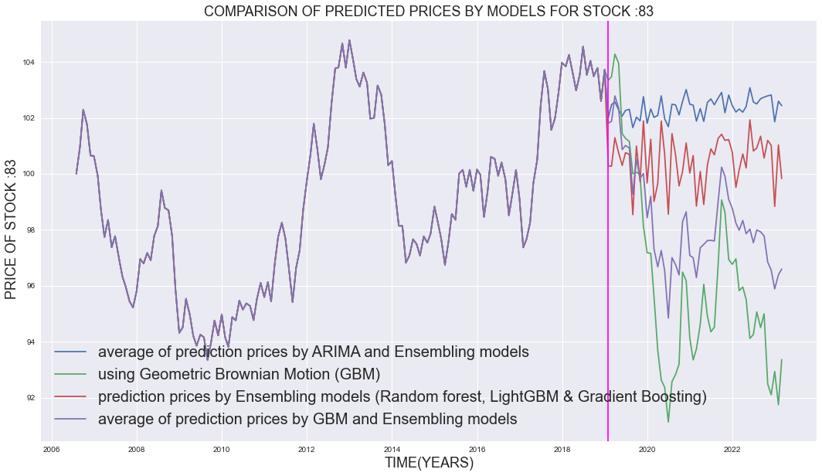
COMPARISON OF MODEL PREDICTIONS.
Upon comparing the predictions derived from averaging the AUTO ARIMA model with ensembling models and predictions solely obtained from ensembling models, the differences observed were minimal.
Notably, the ARIMA model's predictions exhibited significantly large prediction intervals, which raised concerns about their reliability.
Consequently, the decision was made to select the average of predictions derived from simulations of Gradient Brownian Motion (GBM) and ensembling models.
This choice was supported by the fact that the Mean Squared Error (MSE) between the training data and the most accurate-fit GBM simulation was less than 3.0, indicating the higher relevance and suitability of GBM simulations over the predictions obtained from AUTO ARIMA.
TEST DATA
TRAINING DATA

Slide 19
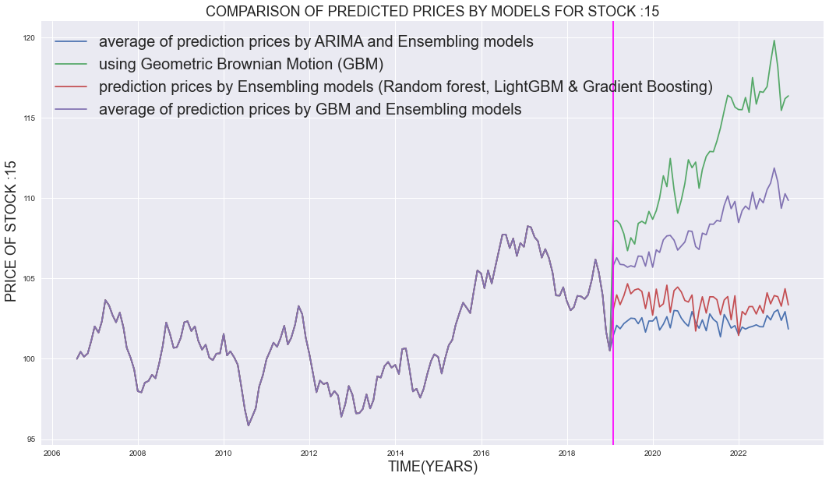
COMPARISON OF MODEL PREDICTIONS.
Upon comparing the predictions derived from averaging the AUTO ARIMA model with ensembling models and predictions solely obtained from ensembling models, the differences observed were minimal.
Notably, the ARIMA model's predictions exhibited significantly large prediction intervals, which raised concerns about their reliability.
Consequently, the decision was made to select the average of predictions derived from simulations of Gradient Brownian Motion (GBM) and ensembling models.
This choice was supported by the fact that the Mean Squared Error (MSE) between the training data and the most accurate-fit GBM simulation was less than 3.0, indicating the higher relevance and suitability of GBM simulations over the predictions obtained from AUTO ARIMA.
TRAINING DATA
TEST DATA

Slide 20
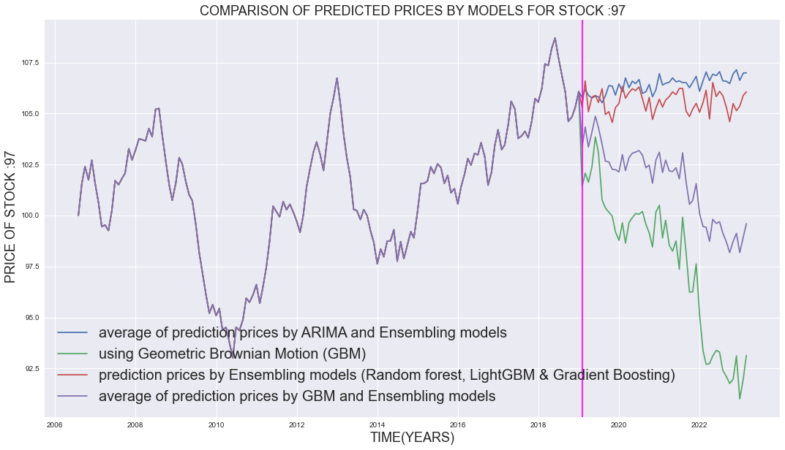
COMPARISON OF MODEL PREDICTIONS.
Upon comparing the predictions derived from averaging the AUTO ARIMA model with ensembling models and predictions solely obtained from ensembling models, the differences observed were minimal.
Notably, the ARIMA model's predictions exhibited significantly large prediction intervals, which raised concerns about their reliability.
Consequently, the decision was made to select the average of predictions derived from simulations of Gradient Brownian Motion (GBM) and ensembling models.
This choice was supported by the fact that the Mean Squared Error (MSE) between the training data and the most accurate-fit GBM simulation was less than 3.0, indicating the higher relevance and suitability of GBM simulations over the predictions obtained from AUTO ARIMA.
TRAINING DATA
TEST DATA

Slide 21

ANKITA ANAND
IIT GUWAHATI
THANK YOU!

